Slide 1
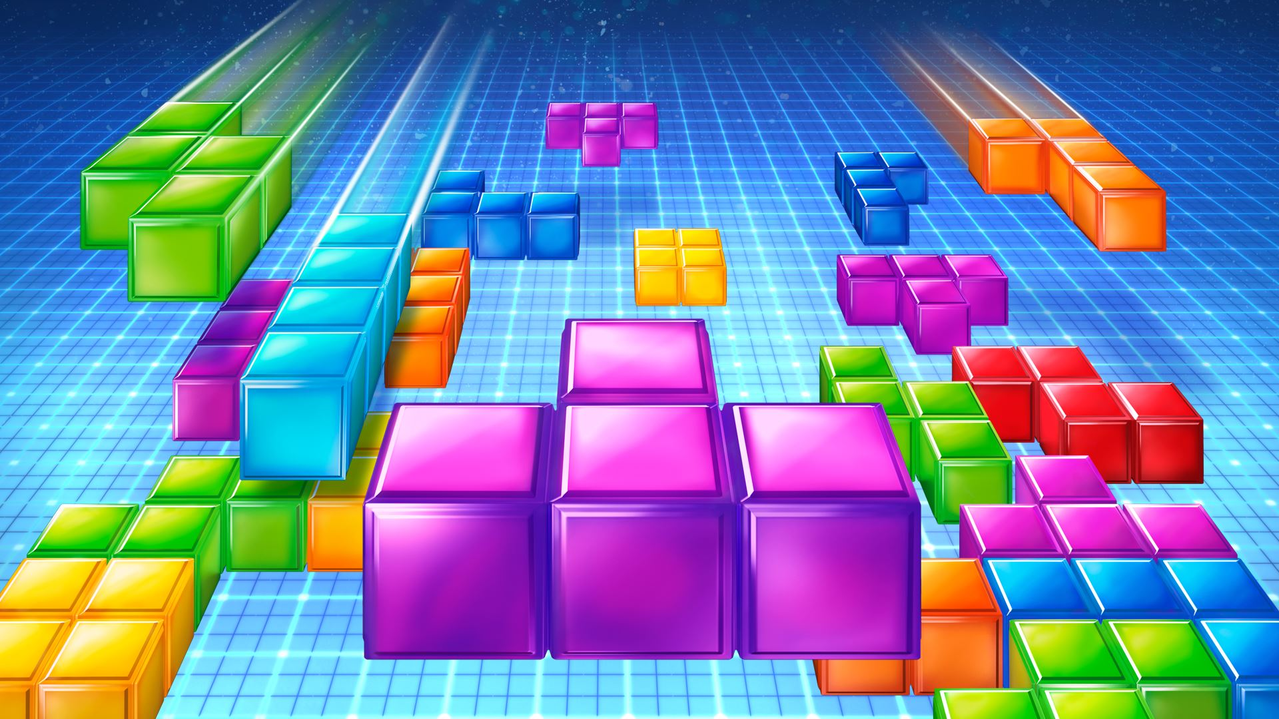
Tetris
Shixuan Zheng and Chengang Zhang

Slide 2
Stuff to include (DELETE THIS BEFORE WEDNESDAY)
Tell us what your project is. (20 pts)
What is your motivation?
Tell us what you did in the project. (20 pts)
What packages did you use?
Any significant modification in the original chat system?
A simple working demo/code (20 pts)
It is time to show your work to all of us
Is the design reasonable? (20 pts)
Analysis of design logic/possible improvements
This is about the impression of your presentation and your workload, being ranked with regard to others (20 pts)

Slide 3
The Agenda
The motivation behind creating Tetris
How it works:
How the player can start the game alone
How the player can start the game with a friend
How the player can see the current ranking
The implementation process
Live demo
Comments and known issues
Possible improvements to the system

Slide 4
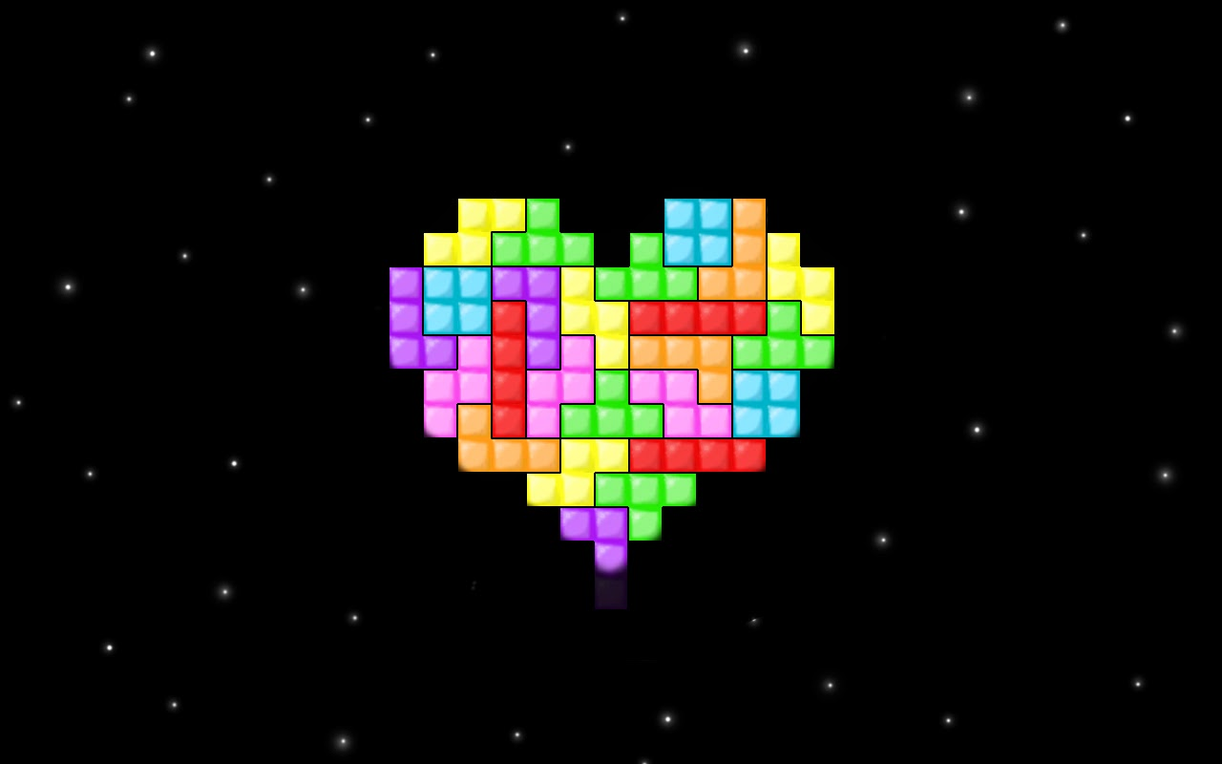
The Motivation

Slide 5
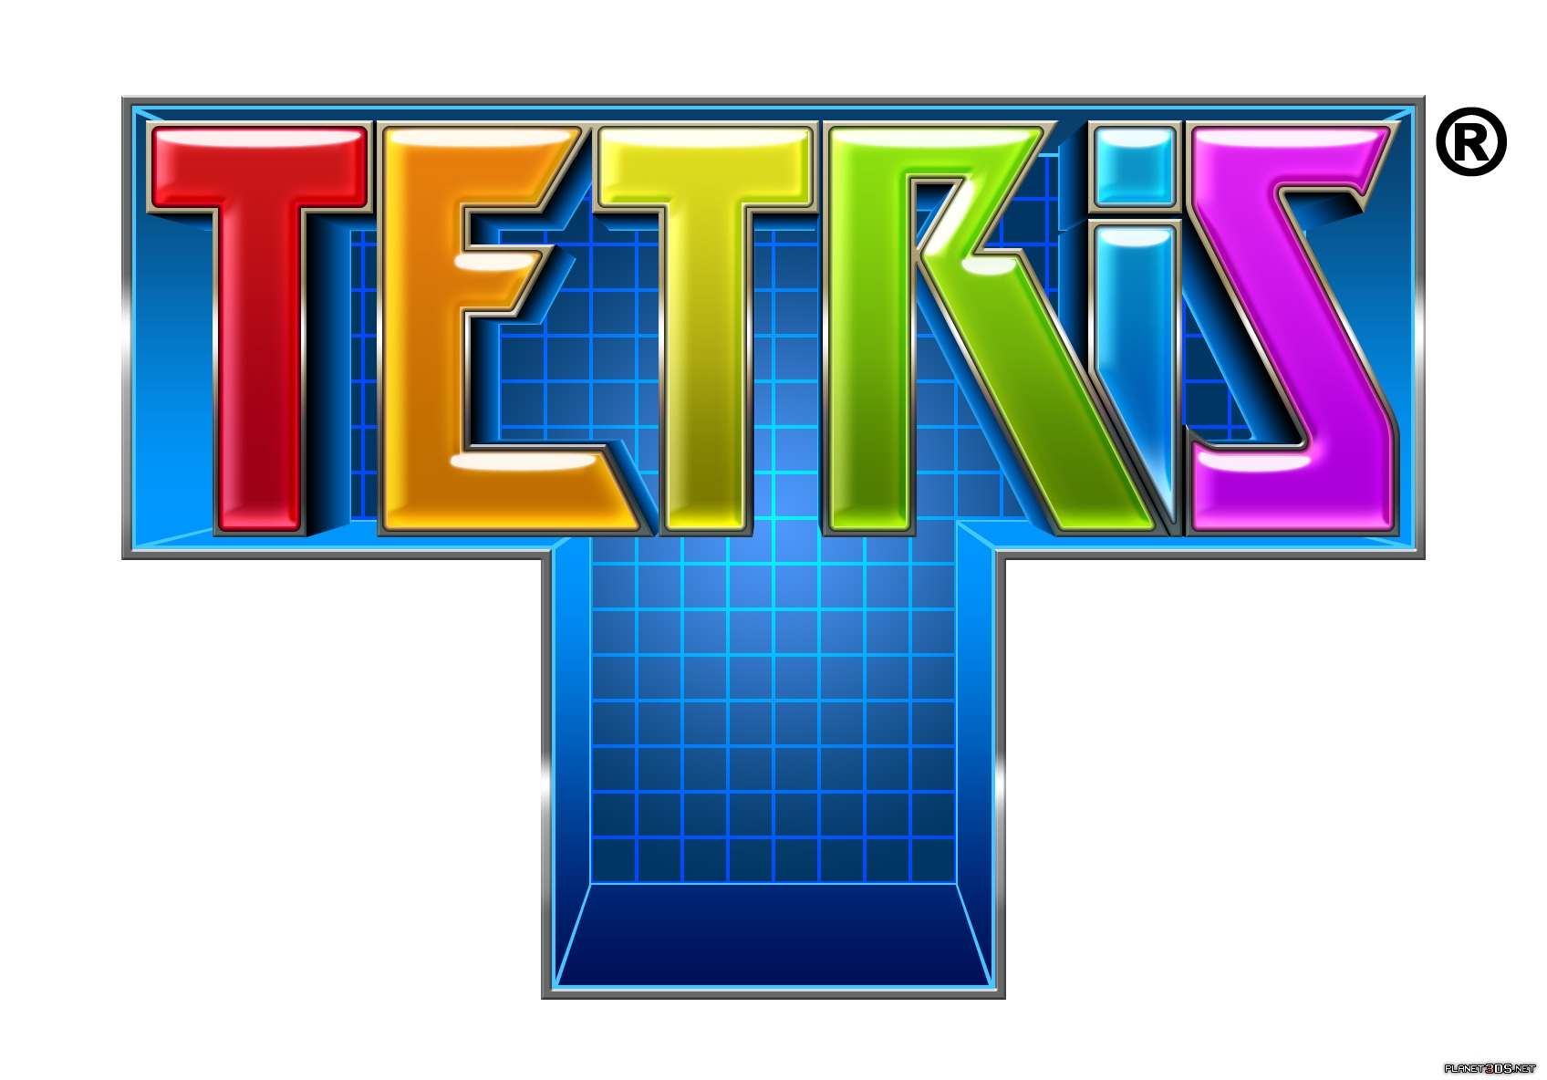

Motivation
We like playing games
We were reminiscing about old games like tetris
We wanted a game that allowed users to compete indirectly
We wanted an easy game that didn’t have a high learning curve.

Slide 6
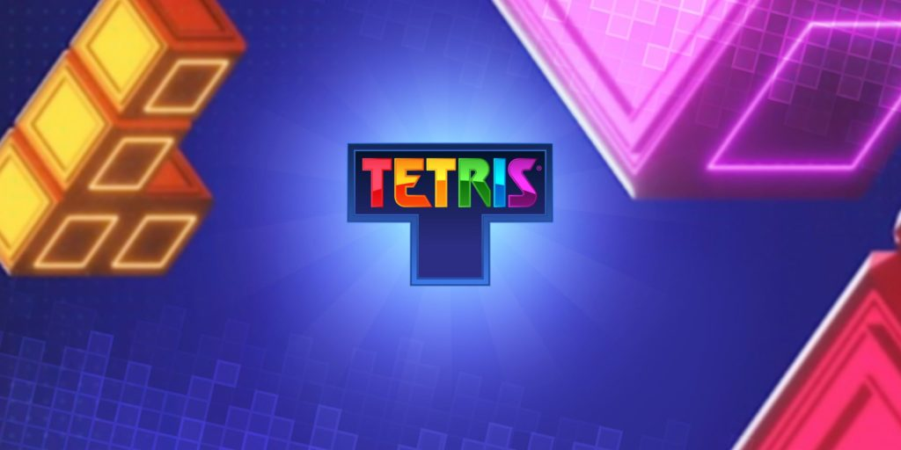
Modifications to Original Chat System

Slide 7
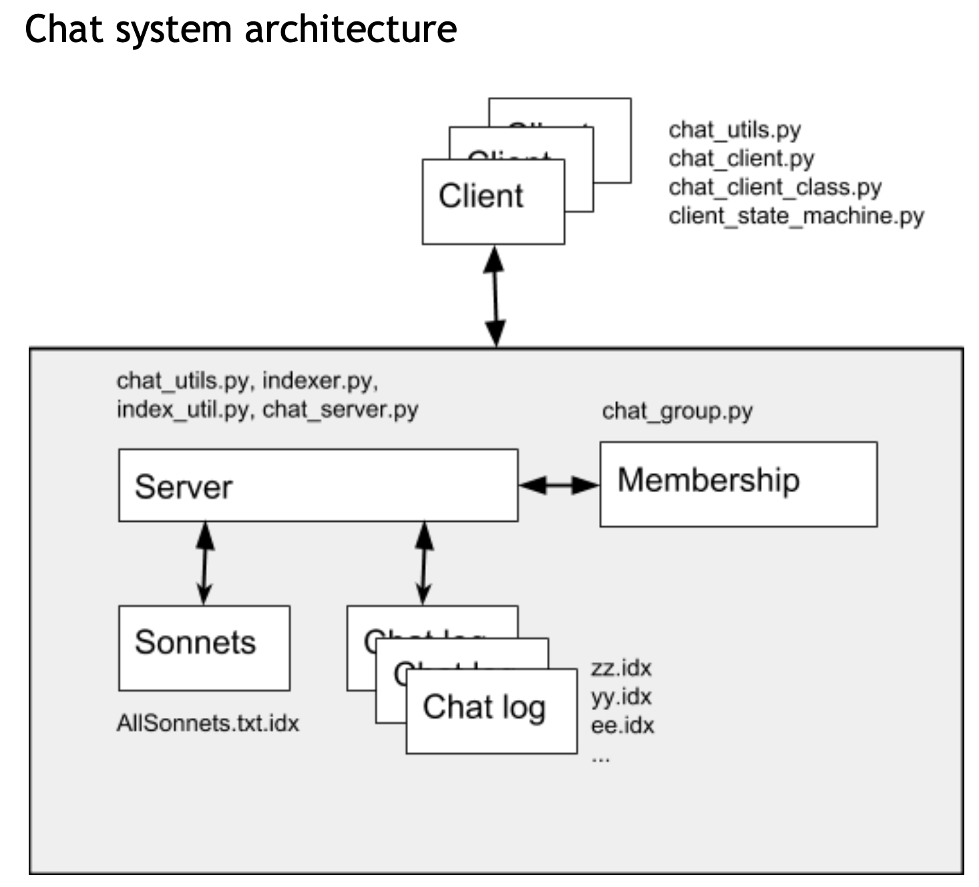
UP3 The Chat System Architecture for UP3

Slide 8
Chat Architecture with Tetris The New Chat Architecture!
Tetris.py
New features
in (RED)
Game Membership
Uses chat_group.py (an instance of Group)

Slide 9
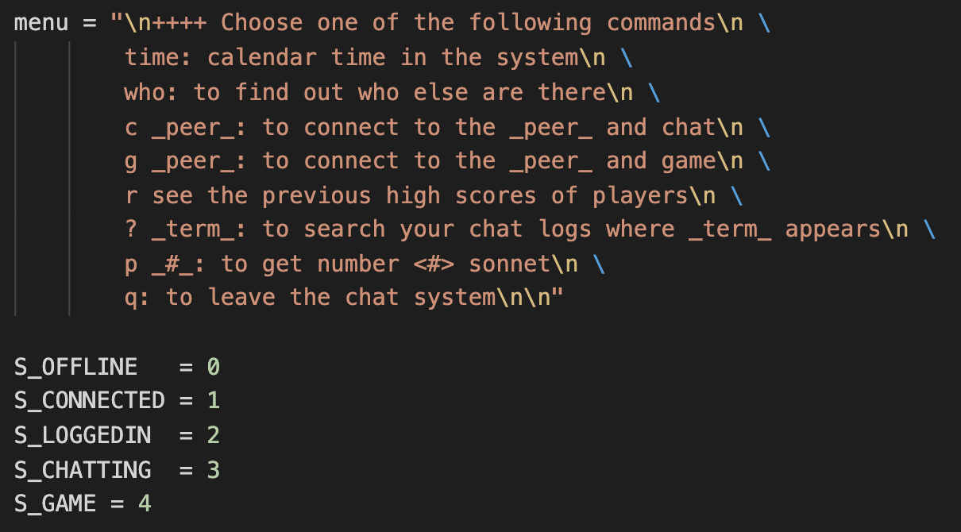
Modifications: Part I client_utils.py
New Menu Options:
’g’ peer
‘r’
New State:
S_GAME

Slide 10
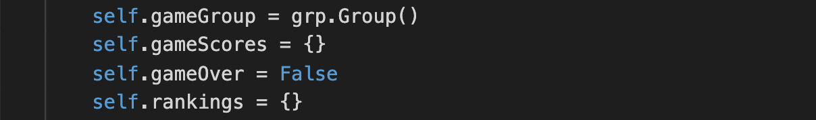
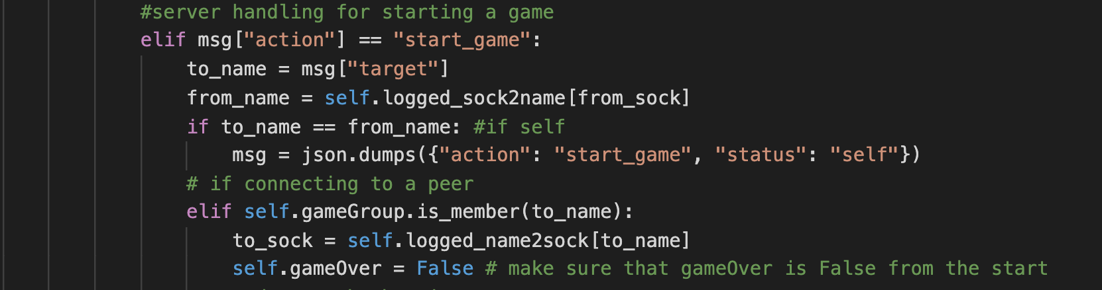
Modifications: Part II chat_server.py
New data members:
gameGroup
gameScores
gameOver
rankings

Slide 11
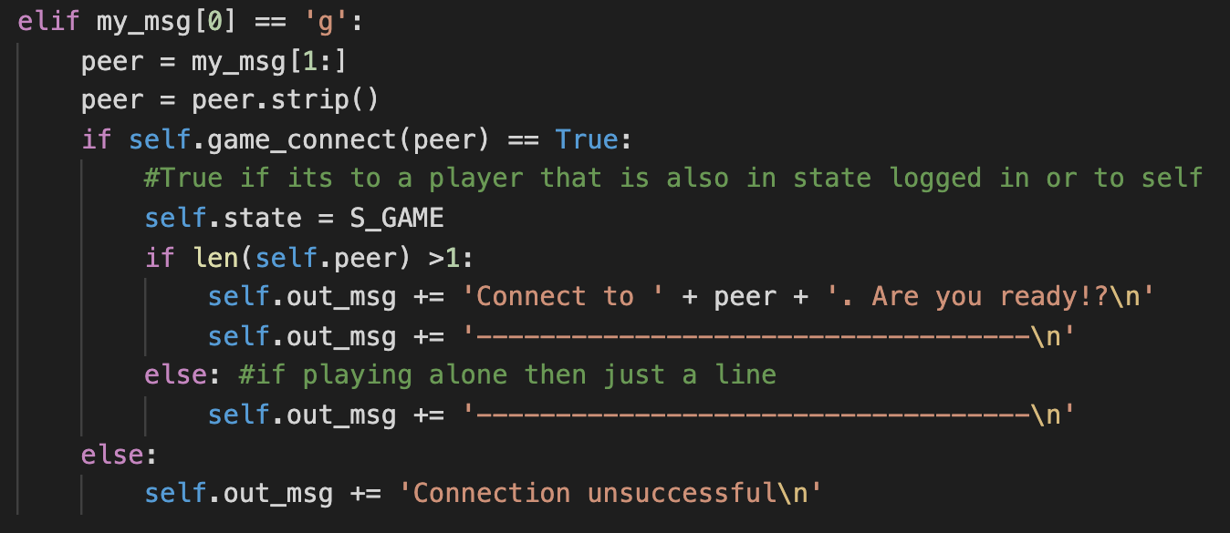
Modifications: Part III client_state_machine.py
When the user’s requested action is game, the client_state_machine will call a function that sends a request to the server.
This is very similar to how the users connect to other people to chat

Slide 12
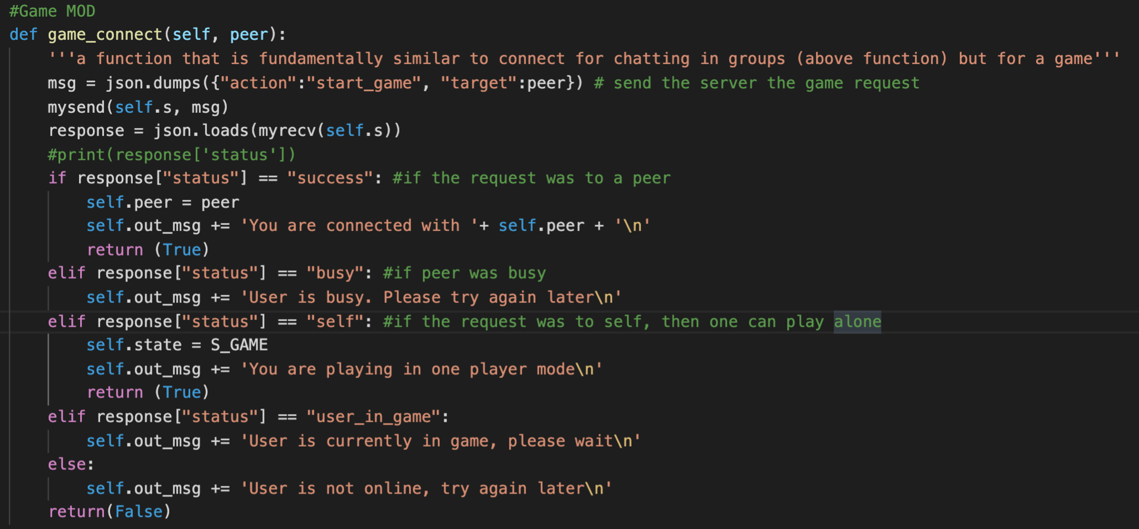
Modifications: Part III client_state_machine.py
Notes:
This is the connection function

Slide 13
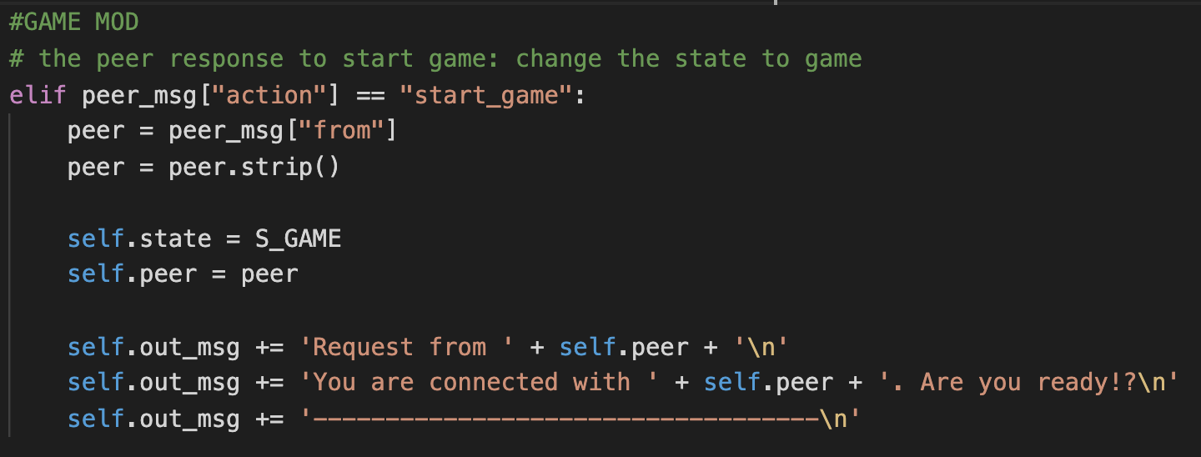
Modifications: Part IV client_state_machine.py
Peer receives the request to play a round of tetris
Notes:
Function similar to the function to connect two people into a group to chat

Slide 14
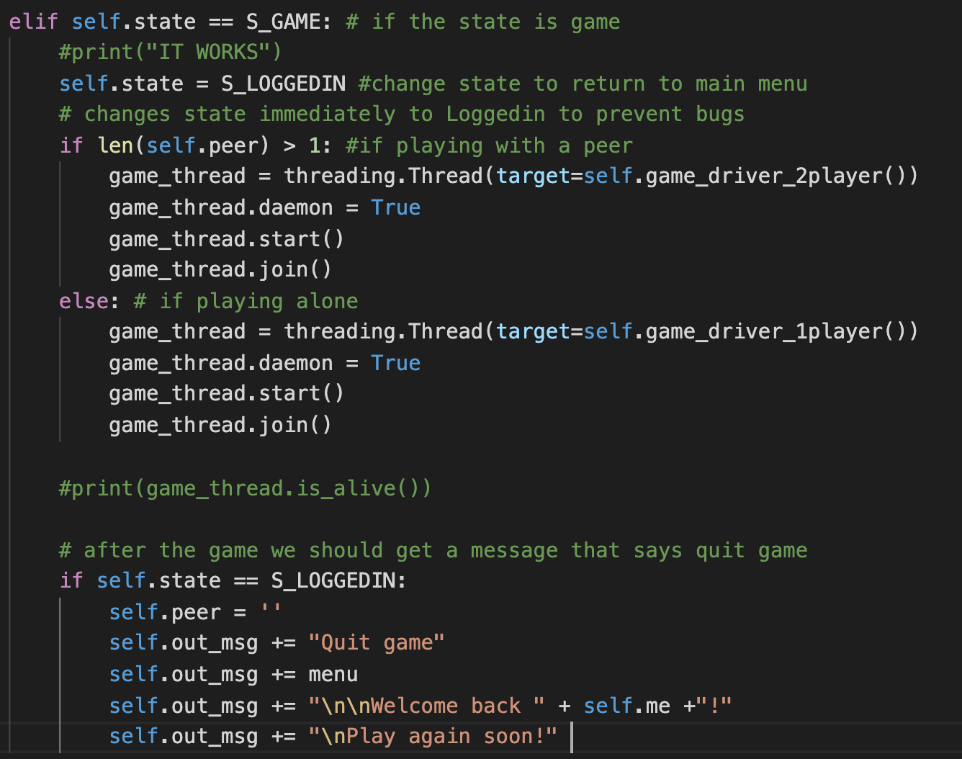
Modifications: Part V client_state_machine.py
Once the state is changed to S_GAME
If the player is playing alone the 1 player function would be called
If the player is playing with a peer then the 2player function would be called
Once the game ends, the player would receive a welcome back message
Notes:
Function similar to the function to connect two people into a group to chat

Slide 15
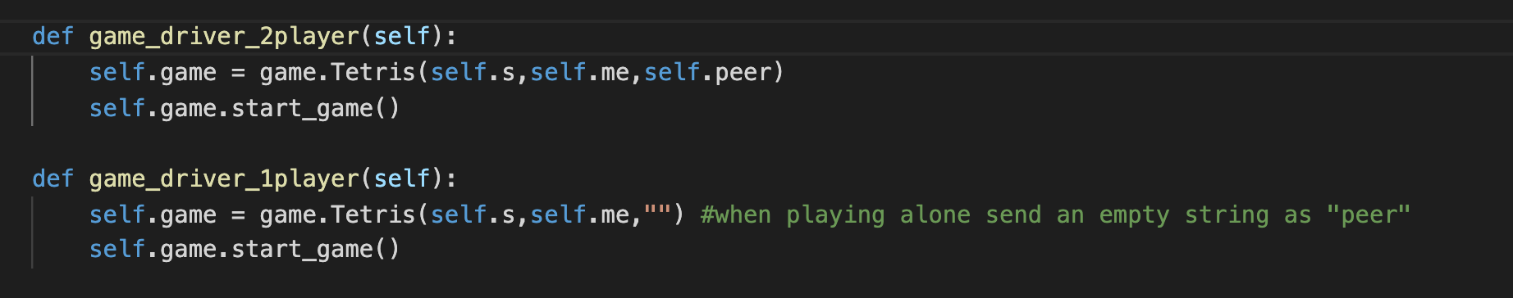
Use of Threading client_state_machine.py
The functions to start up the game
Notes:
Function similar to the function to connect two people into a group to chat

Slide 16
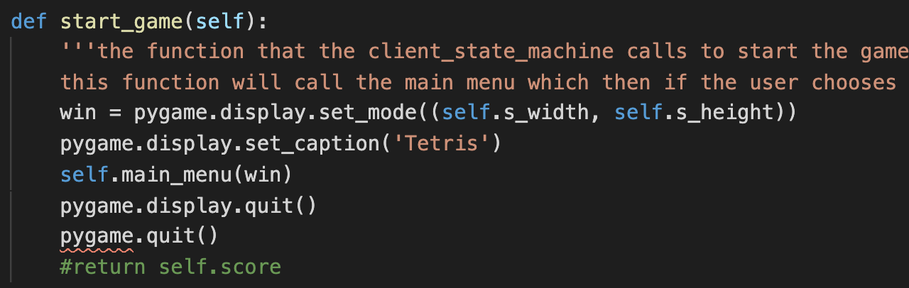
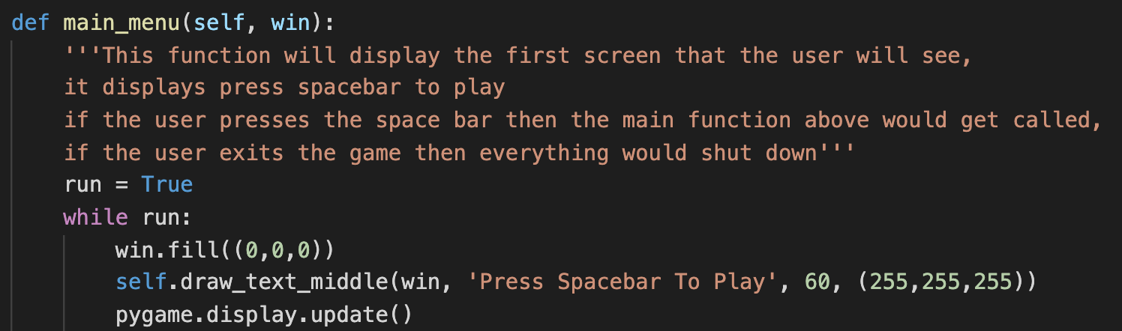
Approach/Logic of Tetris file Tetris.py
Driver code (I)
Main Menu (II)
Notes:
Add a photo of the start_game function

Slide 17
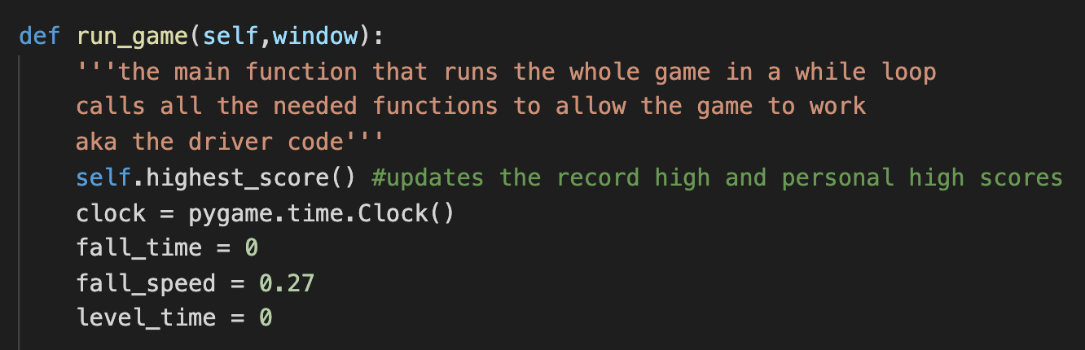
Approach/Logic of Tetris file Tetris.py
run_game method that runs the game in a while loop (III)

Slide 18
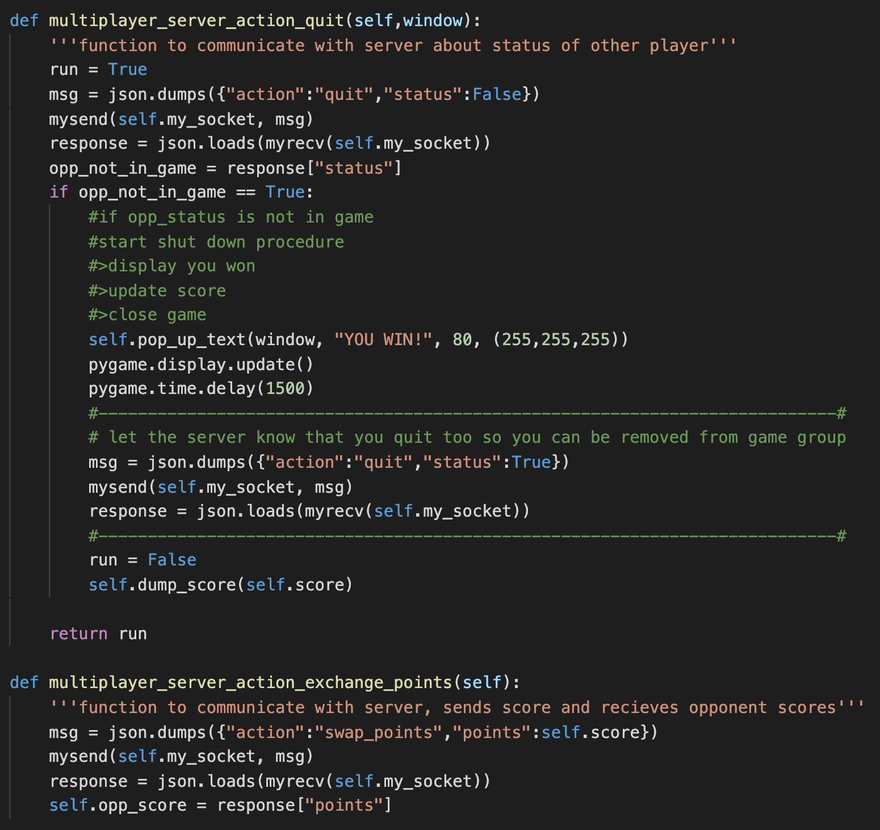
Approach/Logic of Tetris file Tetris.py
Server communications at the start of every while loop
Quit
Exchange Points

Slide 19
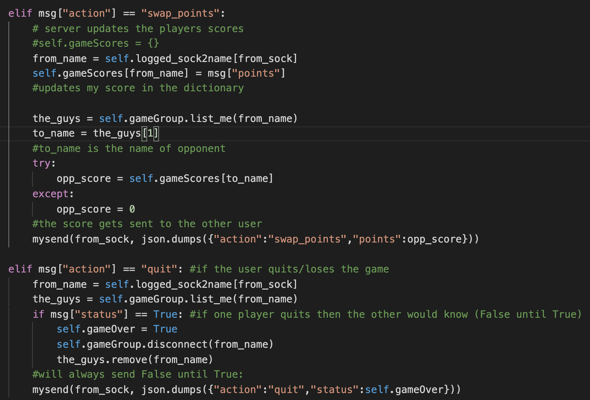
How it was implemented
chat_server.py
How the server responds to the game sends

Slide 20

Live Demo

Slide 21
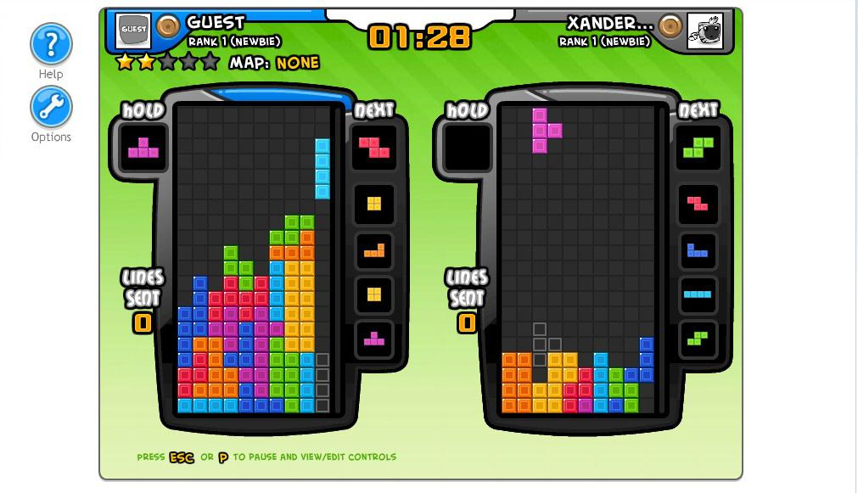
Possible Improvements
In 2 player mode, allow players to see opponents tetris screen
Create a hold mode in the game to allow players to hold pieces for future use
In 2 player mode, add a AI as the opponent

Slide 22


